Slide 1
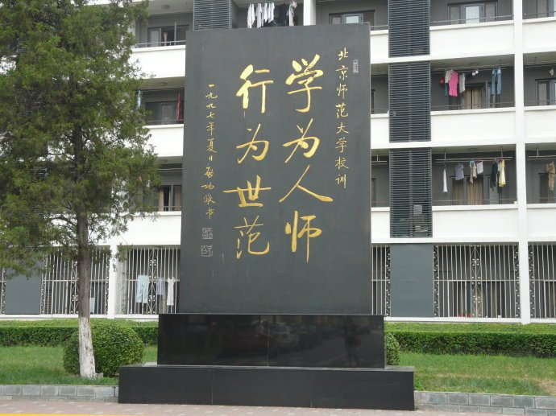


Welcome to Cathy’s English class!
Something about me

Slide 2


Slide 3

Q3 讲述一次在英语学习过程中让你很有成就感的经历。
Q1 你喜欢学英语吗？为什么？
Q2 在学习英语过程中，你是否遇到过／正遇到某种困难？
Q4 你觉得要想学好英语，最重要的是做到哪几点？

Slide 4
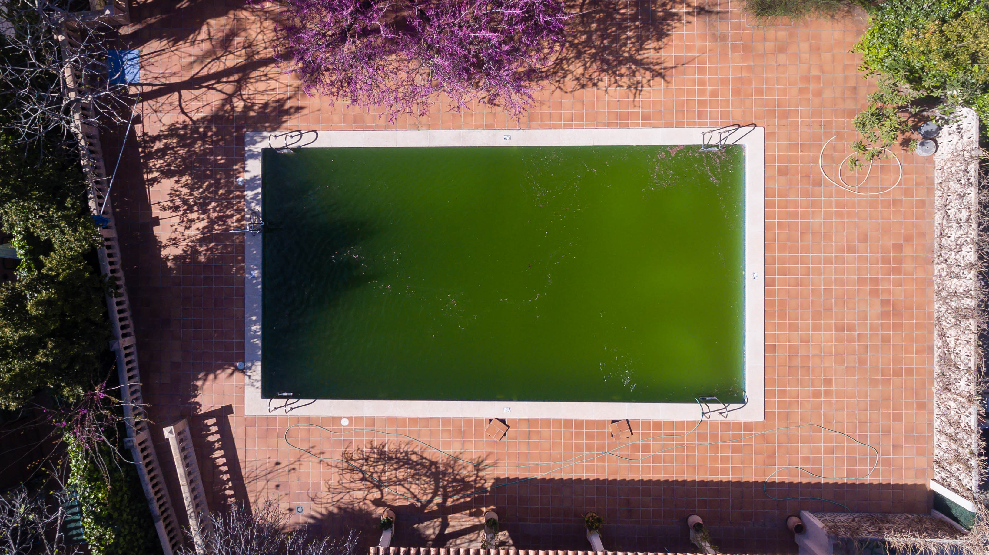
Speak English
Think about how to learn
Consult your “teachers”

Slide 5

The importance of reference books
A grammar book
A vocabulary book
An English-English dictionary
(At least an English-English/Chinese dictionary)

Slide 6


柯林斯高阶英汉双解学习词典(第8版)2017.1
Evacuate: If people evacuate a place, they move out of it for a period of time, especially because it is dangerous.
牛津高阶英汉双解词典(第9版) 2018.3
Evacuate: to move out of a place because of danger, and leave the place empty
All dictionaries are ok, what matters is that you have one!

Slide 7
English Course in QBHS
Listening：VOA & BBC，Model test
Speaking：Pronunciation, speech, drama, debating
Reading：Text, 21st Teems, other topic-related reading materials
Writing：Translation, free writing, newspaper review
课堂类型：早读课、常规课、听力/口语课
作业类型：语言点自测式背诵(notes讲义+及时雨)、背课文、做练习题、翻译句子、造句、报摘每周1篇
本子：默写本、翻译本、错题本、报摘本、笔记本

Slide 8

Important habits:
Speak English
Think about how to learn
Consult your “teachers”
Read/listen to a lot of everything.
Take notes.
Read aloud (imitate) and recite.

